Slide 1
High Performance Scientific Computing
SOMNATH ROY
MECHANICAL ENGINEERING DEPARTMENT, IIT KHARAGPUR
Module : OpenMP Programming
Lecture : Introduction to OpenMP

Slide 2
CONCEPTS COVERED
Thread parallelism
Compilation and execution of OpenMP program
OpenMP programming model
OpenMP data handling- shared and private variables

Slide 3
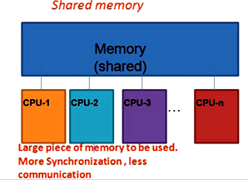
Shared memory parallel programs
In a shared memory architecture, different processors are connected with a common address space.
For symmetric multi-processors (SMP), this address space is physically the same memory location.
Concurrent instructions run in different processors while using the same memory.
Cache coherent protocols are required. False sharing and contention degrades the performance.
Synchronization across processors are important at different stages of the program.

Slide 4
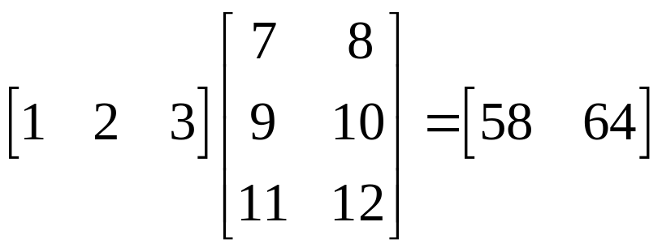
Threads
Symmetric multiprocessing (SMP) systems, shared memory parallel computers (and GPU-s too) provide system support for the execution of multiple independent instruction streams.
These instruction streams which use data stream from a common address space are known as threads.
Threads run as a part of main program using SIMD architcture, or, even MIMD (SPMD) model.
Although the threads may run independently in different processors, they are often needed to perform synchronization using barrier calls or cache coherency protocols.
Thread based parallelization is an alternative of message passing based programs, which are deployed for distributed memory systems
thread-1
thread-2

Slide 5
Features of threaded parallelization
Portability: Threaded applications can be developed on serial platforms and run on parallel machines without any change. In case, the number of threads are more than number of available processors, they may be executed sequentially through a do-loop.
Latency hiding: If multiple threads operate in the same processor, the latency of one thread due to memory access, I/O, communication etc. is masked by the execution of the other threads in the same processor.
Scheduling and Load-balancing: Many threaded application shows a granular structure, which makes it easy to map the tasks (group of threads) to different processors evenly minimizing latency due to idle time in some processors.
Ease of programming: It is easy to identify regions of the main program which has high
concurrency and programmer can specify threads using simple API-s like p-threads, openMP
Etc.

Slide 6
Features of threaded parallelization
Any program will have a certain sequential component in it. Threading can be done only on the parallel part of the program.
The threads are created and destroyed following a fork-join model
Parallel Part
Multiple threads
Fork
Join
Serial Program
Serial Program

Slide 7
OpenMP- Introduction
OpenMP (Open Multi-Processing) is an application programming interface (API) which supports multi-platform shared-memory multiprocessing programming in C, C++, and Fortran on various shared memory platforms with different instruction-set architectures and operating systems, including Solaris, AIX, HP-UX, Linux, macOS, and Windows.
OpenMP consists of a set of compiler directives, library routines, and environment variables
OpenMP provides a portable and scalable platform for programmers to develop parallel programs
Programmer can add openMP constructs over sequential codes to convert it into a multi-threaded parallel program
OpenMP is managed by the nonprofit technology consortium OpenMP Architecture Review Board (or OpenMP ARB) jointly defined by a group of major computer hardware and software vendors
OpenMP has been standardized over last 20 years in SMP programming

Slide 8
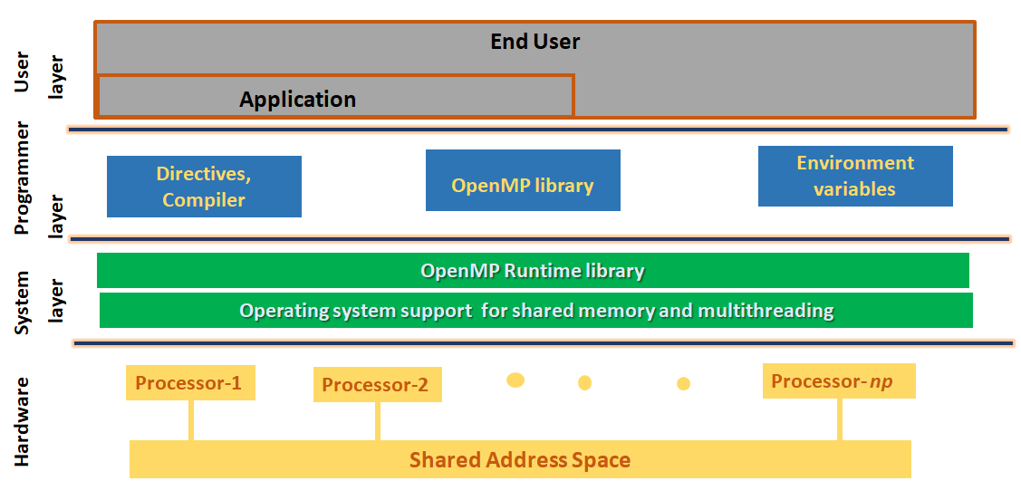
OpenMP Basics: software subsystems
From Tim Mattson’s OpenMP Hands-on Tutorial

Slide 9
Compilation and execution of OpenMP program
Installation: GNU (gcc) provides support for OpenMP starting from its version 4.2.0. So if the system has gcc compiler with the version higher than 4.2.0, then it must have OpenMP features configured with it.
OpenMP runs in C/C++/Fortran programs and also works with commercial compilers like Intel and PGI. For more details visit www.openmp.org
Compilation
Compiler | OpenMP compiler option | Default number of threads (If OMP_NUM_THREADS not set)
GNU (gcc, g++,gfortran) | -fopenmp | Number of available cores in the SMP
Intel (icc,ifort) | -openmp | Number of available cores in the SMP
Portland Group (pgcc,pgCC,pgf77,pgf90) | -mp | one thread
It is important to set the number of threads before execution of OpenMP codes

Slide 10
Compilation and execution of OpenMP program (cont)
Specifying the number of threads: $ export OMP_NUM_THREADS=8
--- number of threads set to 8
In practice number of threads is not set greater than number of cores
Though the number is set before execution, less number of threads may run through OpenMP constructs -- #pragma omp parallel num_threads(4) will run as 4 threads
Runtime function through may also set a different number for threads: omp_set_num_threads(4) -- number of threads set to 4 although the set value was different!
Execution
Running the OpenMP compiled executable directly will launch the parallel program over number of threads set by OMP_NUM_THREADS or the default (if not set)

Slide 11
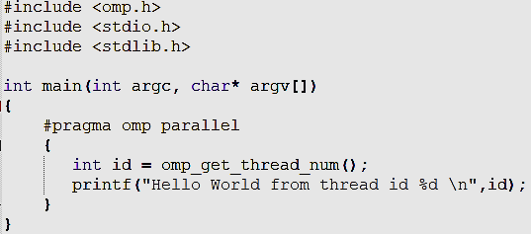
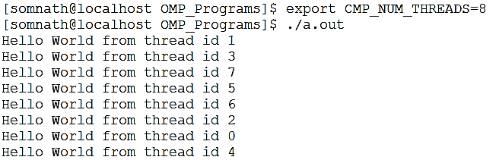
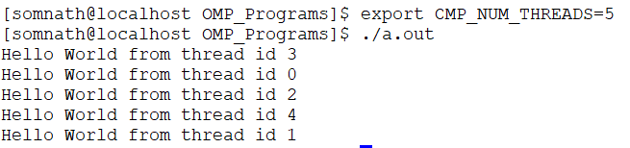
Sample OpenMP program
Hello World program
In c:
OpenMP header file
Directive for parallel region with default no. of threads
Runtime library function, returns thread id
Sample output
Parallel region ends

Slide 12
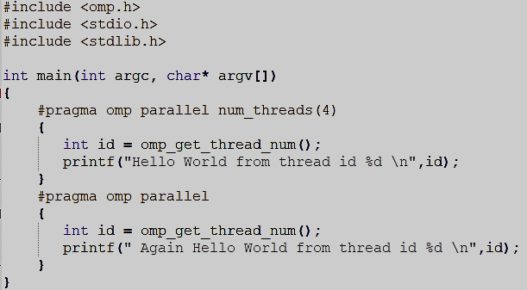
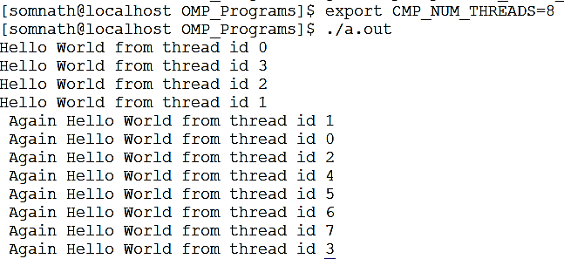
Sample OpenMP program
Hello World program
The outputs are not written sequentially
Can this code be run as threads less than the set number of threads?
If nothing is specified, number of threads is the default or set by export before execution of the program.
Else, number of threads can be specified by (i) runtime function omp_set_num_threads() or by a clause of parallel construct directive
Parallel directive with clause: No. of threads set as 4
one parallel loop ends, the other starts
No. of threads set as default

Slide 13
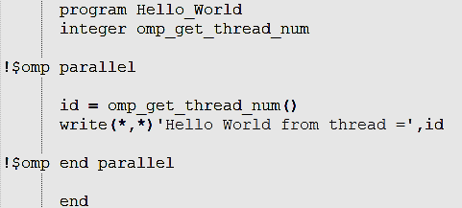
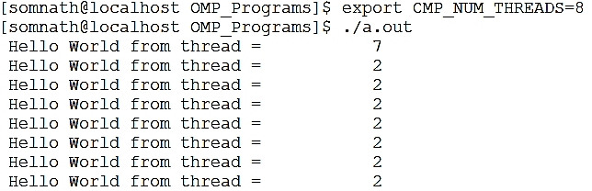
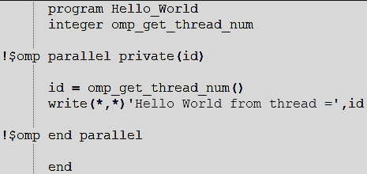
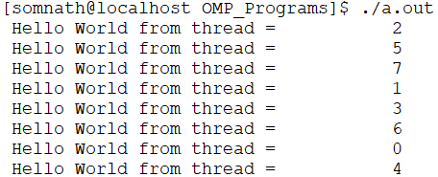
Sample OpenMP program- Fortran
Output
Fortran default i-n integer, rest real.
Variable id must be different for different variables, but being a s shared memory machine, Fortran treats it as a common shared valued variable– Solution: declaring it as private to each thread. C does it by default for all variable used only in the parallel part
Output

Slide 14
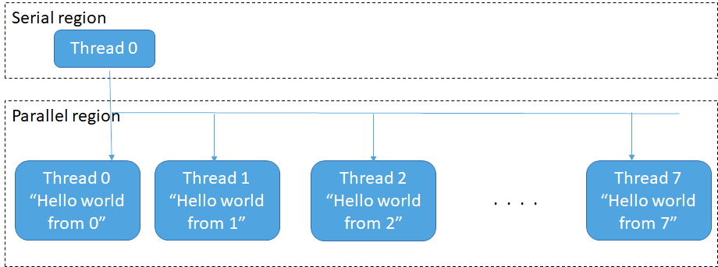
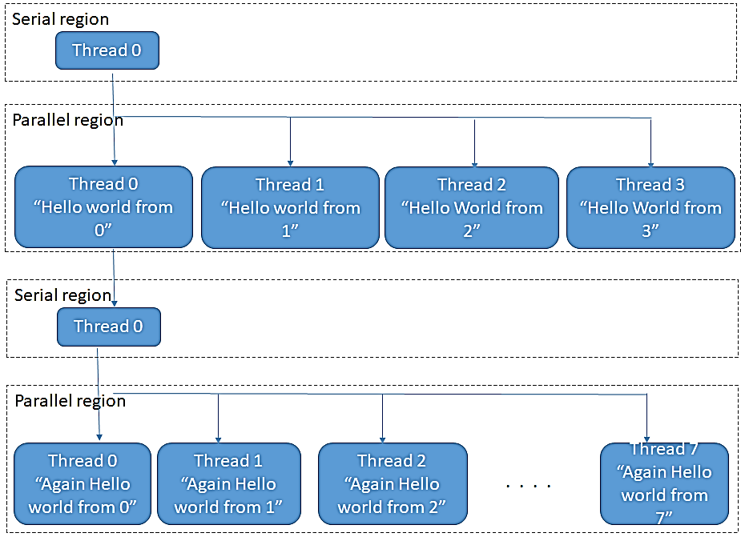
OpenMP programming model
How did the previous codes work?
Simple Hello World:
Hello World with num_threads=4,
followed by - Again Hello World with default (8) num_thread :

Slide 15
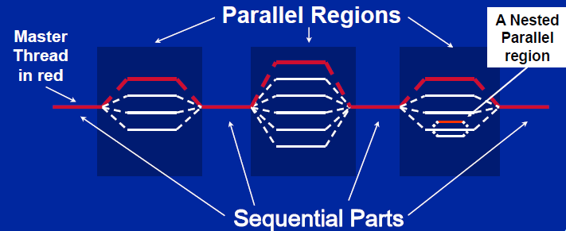
OpenMP programming model
Observations from the previous codes
A Master node (with thread id 0) is active throughout the program.
In a parallel zone, other threads are launched as per set_num_thread. These threads (and the associated processors) become inactive after the end of parallel zone
Thread id 0 is only active in the serial zone.
Multiple threads are again launched at the next parallel zone
-- The number of threads at different parallel zone can be different.
Thread id 0
Fork
Barrier
From Tim Mattson’s OpenMP Hands-on Tutorial

Slide 16
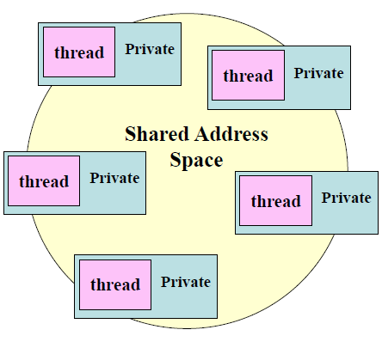
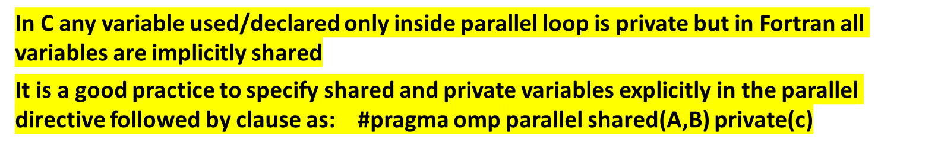
Data handling- shared and private variables
From Tim Mattson’s OpenMP Hands-on Tutorial
All of the threads use memory from a shared address space
Therefore, any memory updated by a thread is visible to all other threads
However, some memory items may be needed by each thread locally to do calculations, these variables may not exist outside parallel region
So, OpenMP has provision of providing private variables to each threads

Slide 17
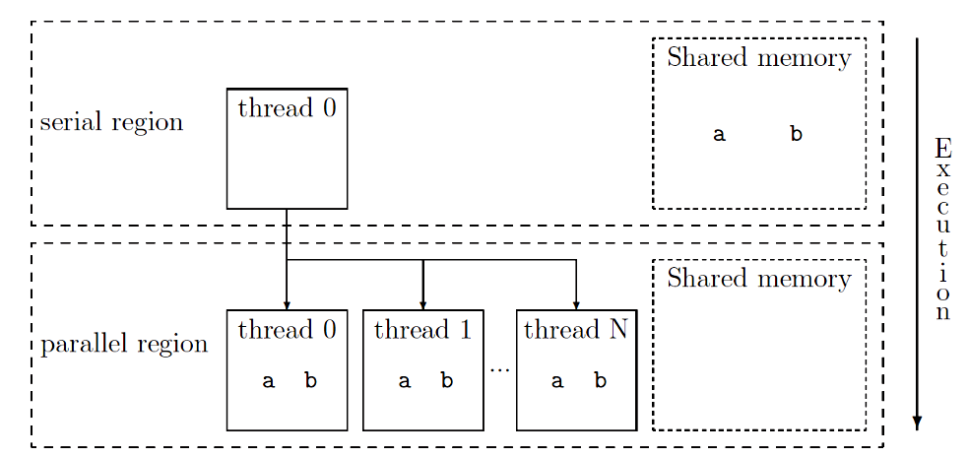
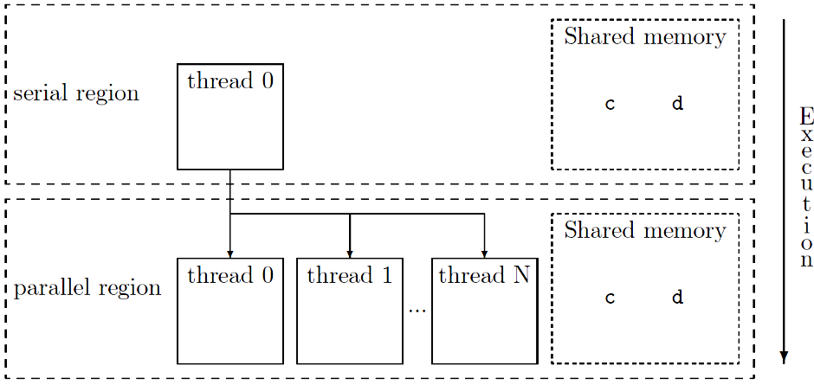
Data handling- (continued)
Consider these directives:
#pragma omp parallel private(a,b) (in C)
or !$omp parallel private(a,b) (in Fortran)
The variables are declared but undefined before the parallel scope and does not remain in the shared memory when threads are launched in the parallel zone
Consider these directives:
#pragma omp shared(c,d)
or !$omp parallel shared(c,d)
The variables are declared and defined before the parallel scope and remain in the shared memory when threads are launched in the parallel zone
Fig courtesy: Miguel Harmanns, Parallel Programming in Fortran using OpenMP

Slide 18
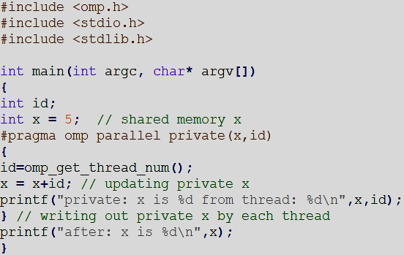
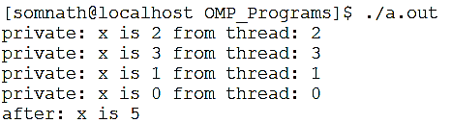
Data handling- (continued)
What will happen if private variables are accessed outside the parallel loop?
They behave as separate variables in the shared memory!
Consider this code
Output in 4 threads
writing the private x output from each thread
starts with initial value of private x=0
shared x remains as a distinct entity outside parallel loop, unaffected by parallel loop computing

Slide 19
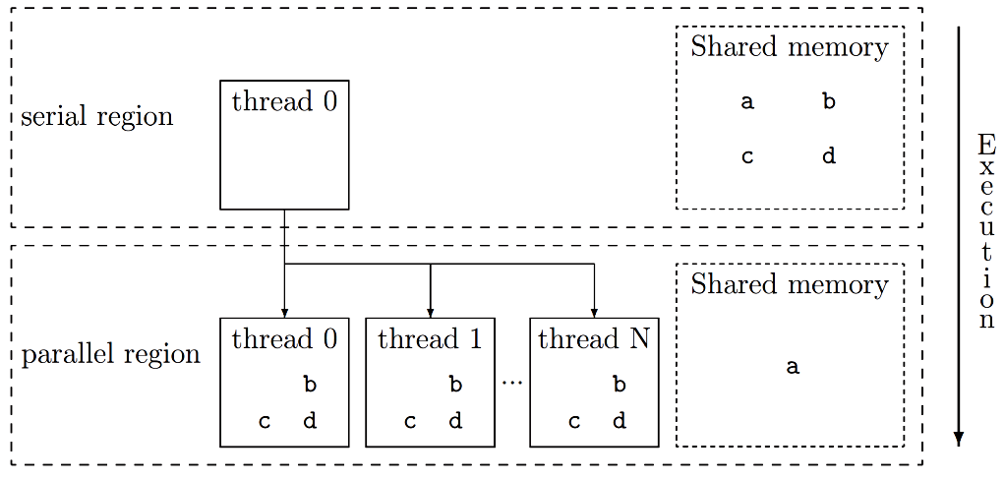
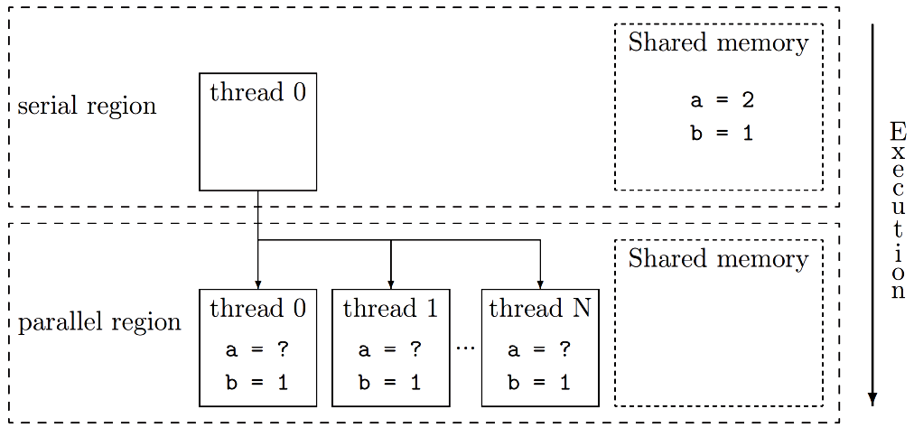
Data handling- (continued)
Consider this directive:
#pragma omp parallel default(private) shared(a)
All variables are by default private, except variable a is shared
A similar directive is: #pragma omp parallel default(shared) private(a)
Firstprivate variable
Consider this code snippet (Fortran):
a=2
b=1
!$omp parallel private(a) firstprivate(b)
Private variable b will be initialized to each thread with the shared memory initial value
This variable is copied from shared memory to private memory space
Fig courtesy: Miguel Harmanns, Parallel Programming in Fortran using OpenMP

Slide 20
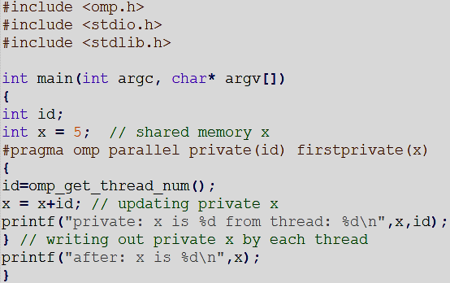
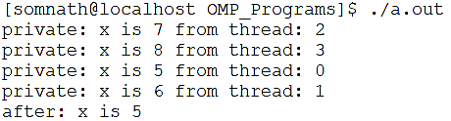
Data handling- (continued)
What will happen to the firstprivate variables before and after the parallel loop?
Consider this code
Output in 4 threads
in the parallel loop, x is initialized with the value set in the shared memory and modified as private variable by the threads
x retains its shared memory value after the parallel loop

Slide 21
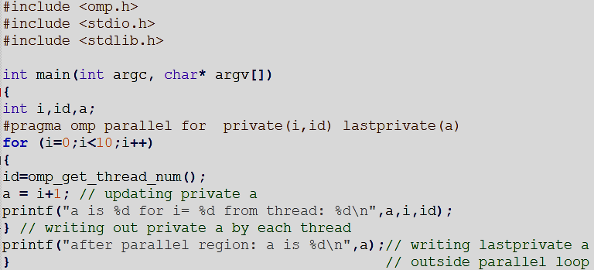
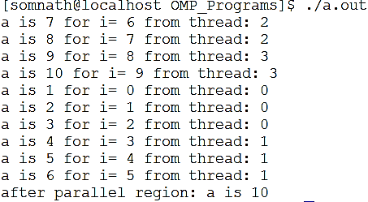
Data handling- (continued)
Lastprivate variable
Consider this code
Output in 4 threads
lastprivate retains last updated value of a private variable inside a parallel loop as shared variable once parallel loop is finished

Slide 22
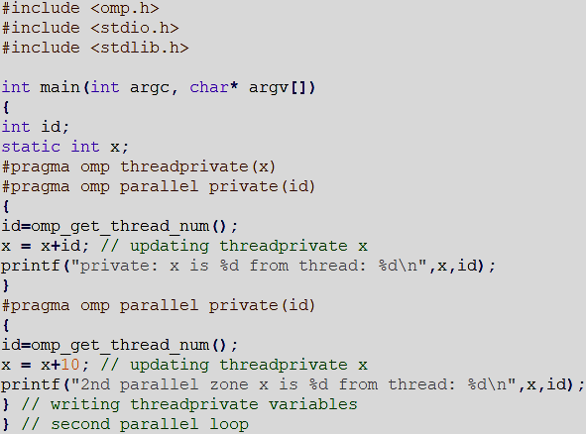
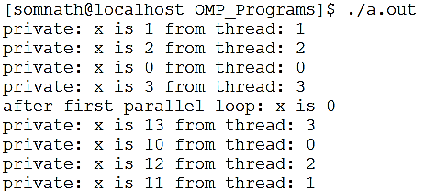
Data handling- (continued)
Threadprivate variable: Each thread retains its value for the private variable even after a particular parallel regime is over and uses it in the subsequent parallel zone
output
If the number of threads are increased in later parallel parts, the new threads contain 0-value for the threadprivate variable

Slide 23
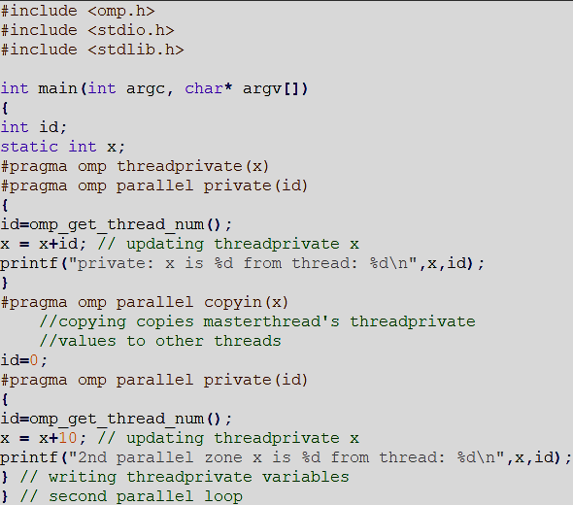
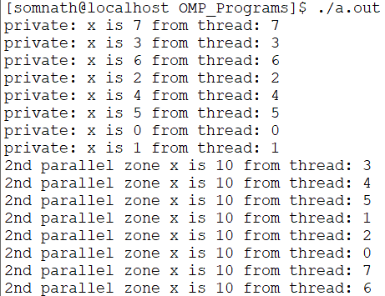
Data handling- (continued)
Copyin: copyin directive copies masterthread’s threadprivate value to all other threads
output
x=0
x=x+10
Copyprivate- boradcasts private data of one processor to other processors in the group. Work with single directive only.

Slide 24
REFERENCES
Introduction to Parallel Computing by Gramma, Gupta, Karypis and Kumar
Parallel Programming in C with MPI and OpenMP by Quinn
Using OpenMP by Chapman, Jopst, Van Der Pas
Parallel Programming in Fortran95 using OpenMP by Hermanns
A “Hands-on” Introduction to OpenMP by Tim Mattson
Parallel Programming for Science Engineering by Eijkhout https://pages.tacc.utexas.edu/~eijkhout/pcse/html/index.html

Slide 25
CONCLUSION
Shared memory programming and thread parallelization discussed
OpenMP programming model discussed
Data handling issues demonstrated

